Slide 2
ADVANTAGES OF PAKISTAN’S PERFUME MARKET
Pakistan’s parallel economy is very strong in comparison to the official economy
Strong buying power
High brand awareness
Availability of all desired brands
Shopkeeper can arrange any brand within 02 days on consumer demand
Shoppers are enjoying very good prices even from Dubai Duty free shop
Banks and stores are giving discounts even on perfumery

Slide 3
CHALLENGES OF PAKISTAN’S PERFUME MARKET
Uncertainty and fluctuation in the exchange rate (authorized and grey market both suffer from it)
High duty structure and taxes
Retail prices are not established
Departmental stores, super markets and drug stores are key avenues for perfume retail
As compared to modern, traditional market is more established
Business module of fragrance is based on wholesale prices, even outlets targeting SECs C & D

Slide 4
Eleganz Luxury (Pvt.) Limited
Pakistan

Slide 8
To introduce fashion and luxury brands in Pakistan’s market with international standards while building on our commitment with our valued partners

Slide 9
To sustain our leadership position in the cosmetics and fine fragrances market of Pakistan

Slide 11
ELEGANZ PARTNERS
Givenchy
L'Oréal Luxe
Shiseido Group
Euroitalia
Guerlain
Hermes
Clarins Group
Bvlgari
Kenzo LVMH FB
Loewe
Micys Company S.p.A
Groupe Bogart

Slide 12
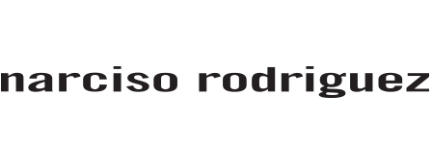
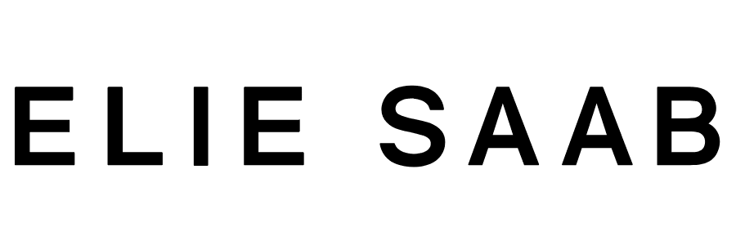
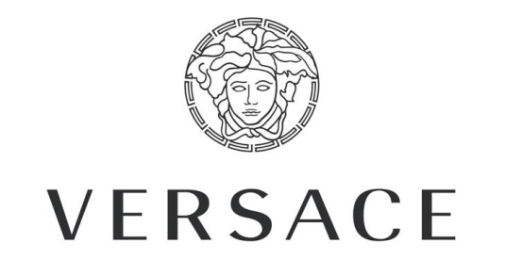
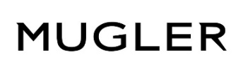
BRAND PORTFOLIO

Slide 13
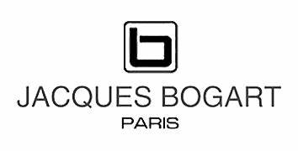
BRAND PORTFOLIO

Slide 14
VISIBILITY OPPORTUNITIES
Personalized Wall Units
Back Wall Units
Gondola
Shelves

Slide 16
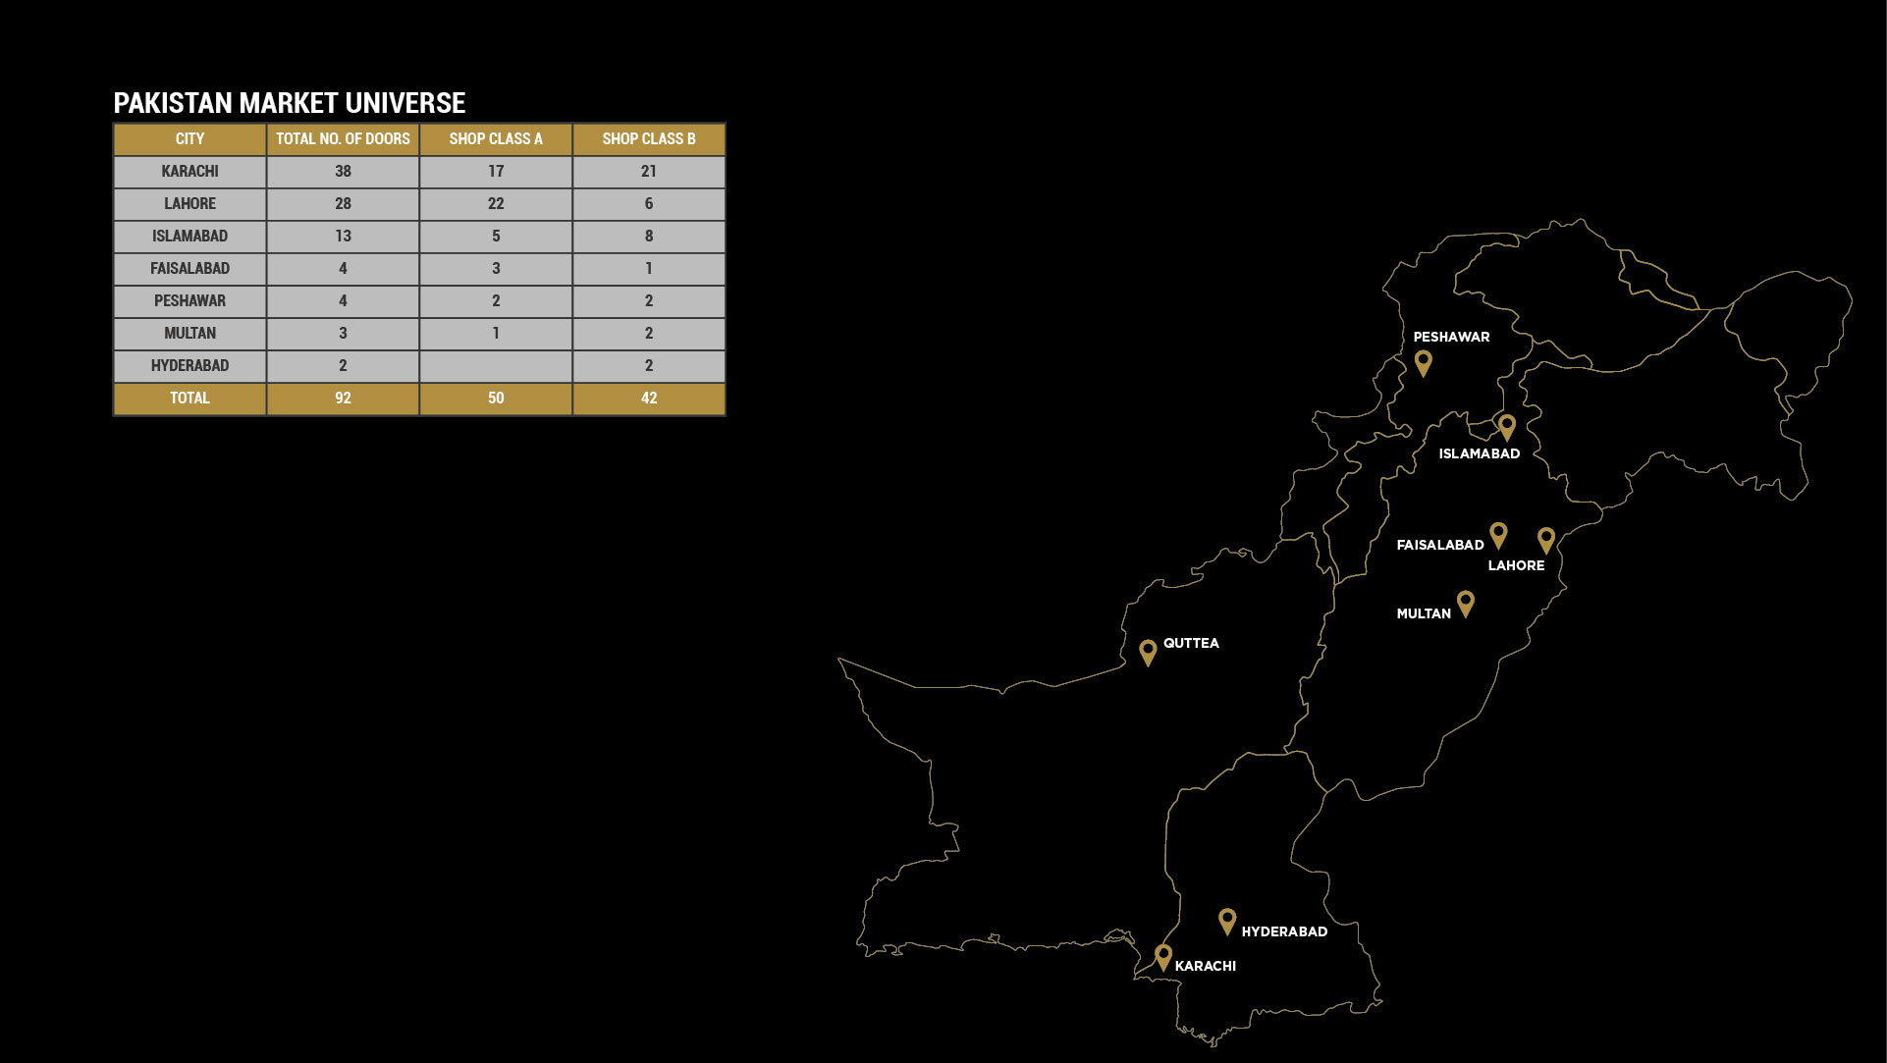
CITY WISE COVERAGE

Slide 18
Eleganz Luxury Development
New Huge investment by implementing new ERP system with the
latest version of SAP Business HANA, this will be great added value
for our reporting system.

Slide 20
STRENGTH
Experienced and progressive leadership
KNOWLEDGE
Market insight and understanding of customers’ aspirations
PRESENCE
Operations in all metropolises of Pakistan
TECHNOLOGY
MIS-based tracking and monitoring on SAP systems
TEAM
High-caliber, energetic professionals
TRAINING
Organized training and skill development of the workforce

Slide 21
Eleganz Luxury Organization Structure

Slide 22
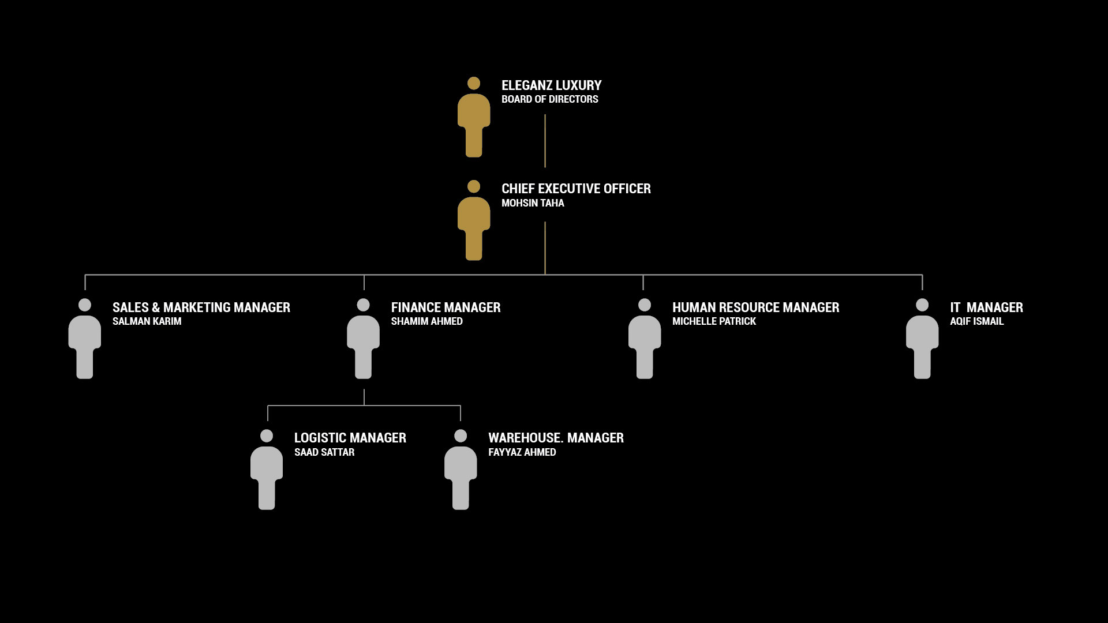

Slide 23
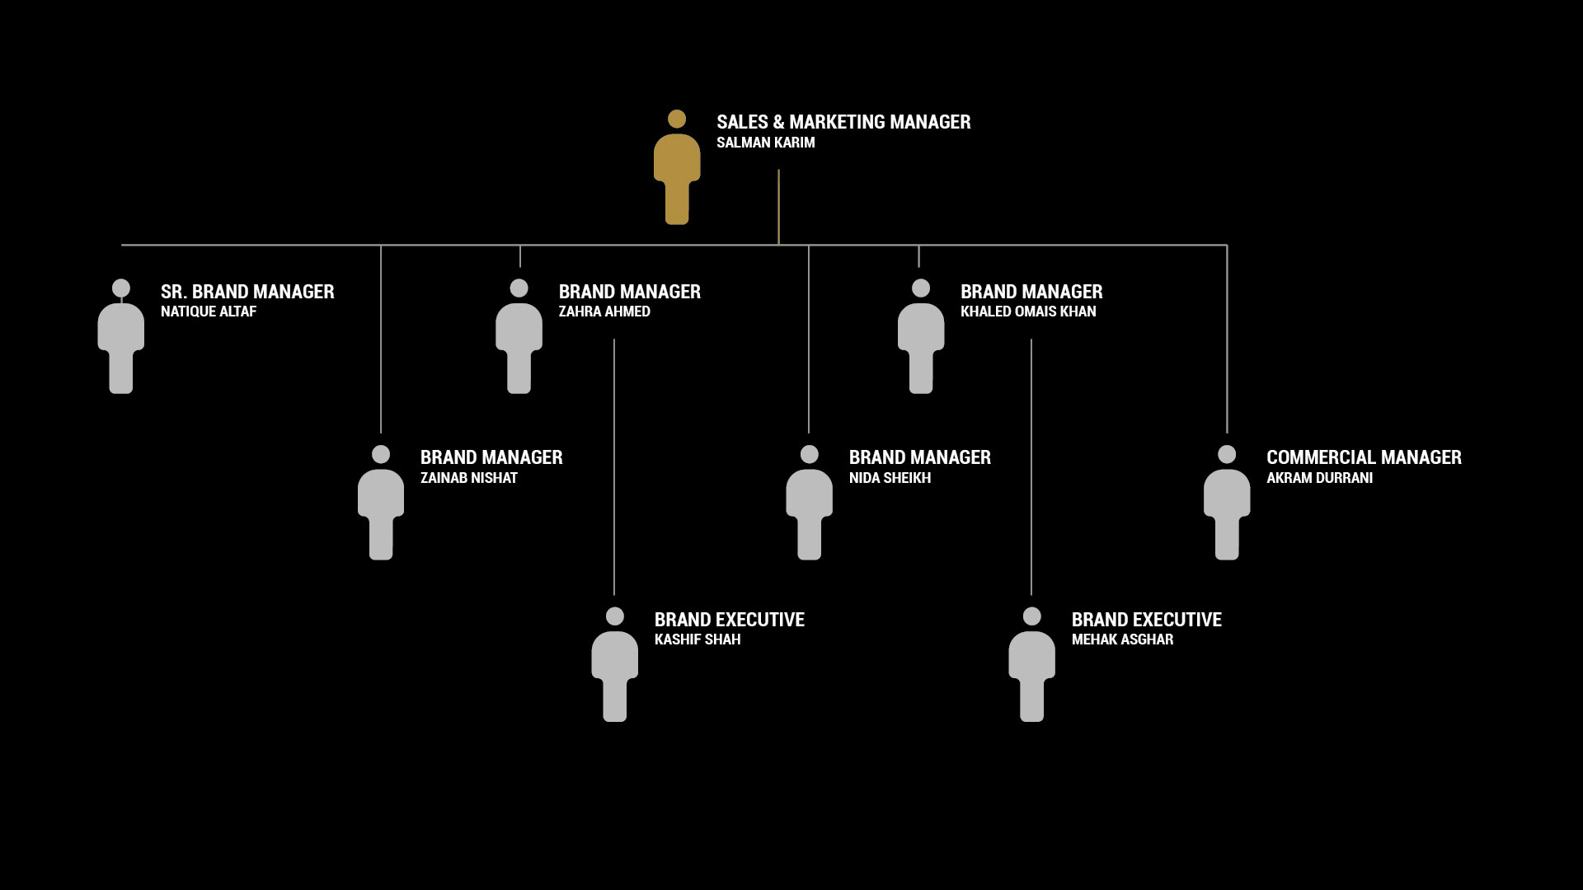

Slide 24
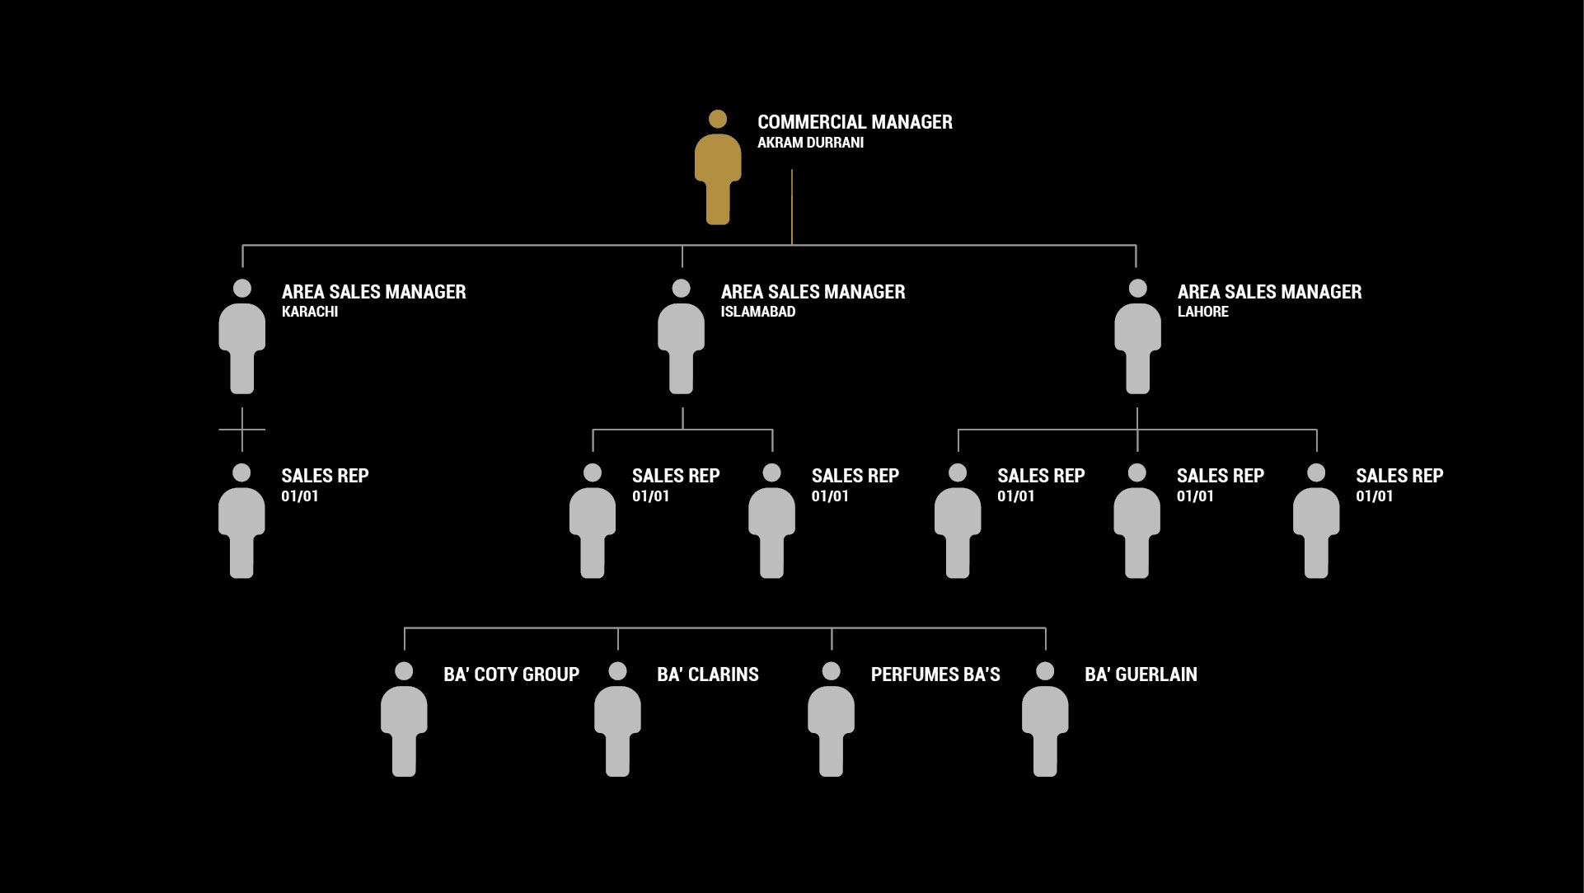

Slide 25
THANK YOU

